Slide 1
Antiquarians in the 21st Century: Opening up our data
TH3-03 : Open Access & Open Data in Archaeology
Emma Jane O’Riordan - ScARF Project Manager
Erin Osborne Martin- Managing Editor of the Society of Antiquaries

Slide 2
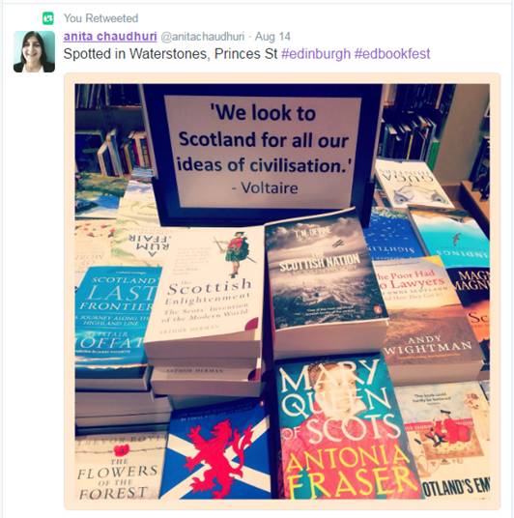
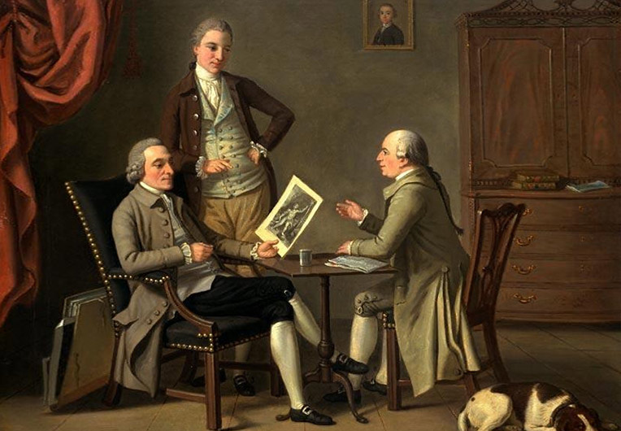
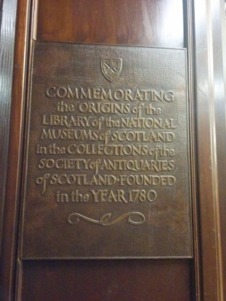
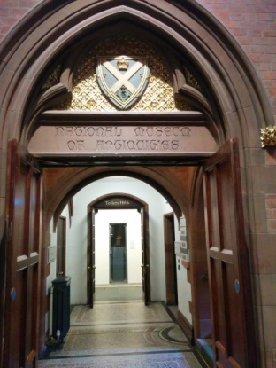
The Antiquaries: A Brief History
Founded in 1780
Incorporated by Royal Charter in 1783
The Society’s purpose is “to investigate both antiquities and natural and civil history in general, with the intention that the talents of mankind should be cultivated and that the study of natural and useful sciences should be promoted.”
Notes:
The Society of Antiquaries of Scotland was founded in 1780, during a period known as the Scottish Enlightenment. This was an era characterised by an outpouring of intellectual, scientific and artistic accomplishments that would affect not just Scotland but the entire Western world.
The Society of Antiquaries of Scotland has been an active publisher of Scotland’s history and archaeology since 1792; the Proceedings of the Society of Antiquaries of Scotland (PSAS), has been the primary journal dealing with Scotland’s past in its British and European context since 1851.
Publication in PSAS has often been seen by many archaeologists as the ‘end’ of the research cycle: excavation is followed by publication, and the process is complete. However, there is increasing awareness that the final report alone does not tell the whole story, and many readers would also like to examine raw data.
In 2001, the Society created a new, fully peer reviewed, freely available online journal, Scottish Archaeological Internet Reports (SAIR), so was an early adopter of Open Access in an archaeological context. SAIR was intended to provide a new, lower-cost publication outlet for detailed archaeological reports; over the last fifteen years it has evolved to include the publication of many different types of projects – including large-scale surveys, gazetteers and conference proceedings – which would not be possible or desirable to publish in print for various reasons.

Slide 3
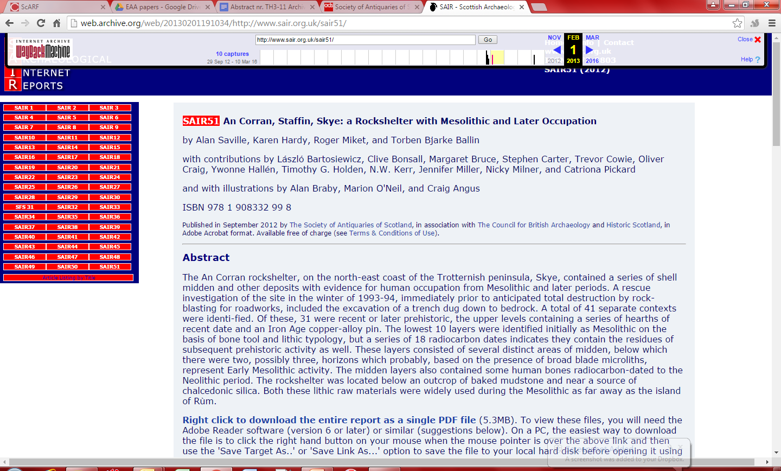
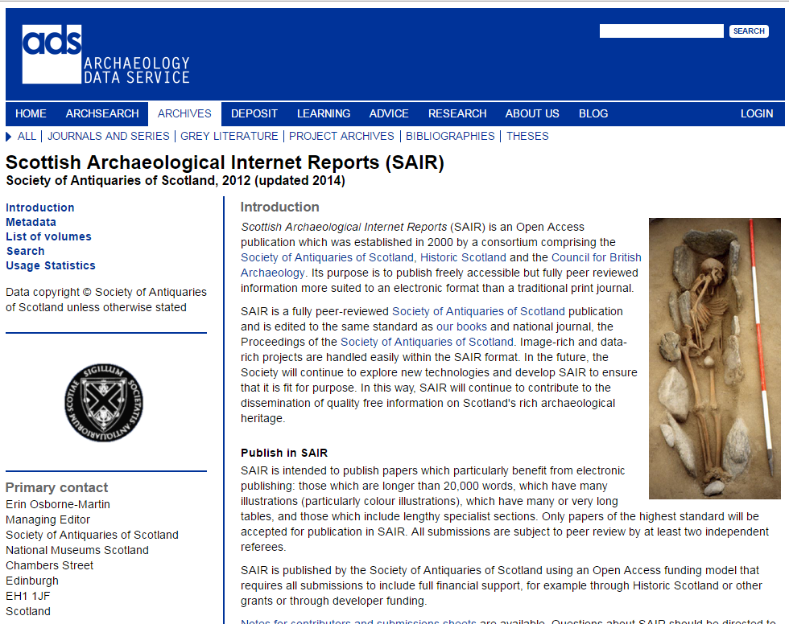
The Society and the ADS
Notes:
In 2001, the Society created a new, fully peer reviewed, freely available online journal, Scottish Archaeological Internet Reports (SAIR), so was an early adopter of Open Access in an archaeological context. SAIR was intended to provide a new, lower-cost publication outlet for detailed archaeological reports; over the last fifteen years it has evolved to include the publication of many different types of projects – including large-scale surveys, gazetteers and conference proceedings – which would not be possible or desirable to publish in print for various reasons.

Slide 4
Scottish Archaeological Internet Reports
Aeolian Archaeology: the Archaeology of Sand Landscapes in Scotland: Selected case-studies, originally given as spoken papers at a Society of Antiquaries of Scotland Specialist Seminar, hosted by Historic Scotland, Edinburgh, May 2004
Gazetteer of Arran Pitchstone Sources: Presentation of exposed pitchstone dykes and sills across the Isle of Arran, and discussion of the archaeological relevance of these outcrops
Mesolithic and later sites around the Inner Sound, Scotland: the work of the Scotland’s First Settlers project 1998– 2004
Scottish Archaeological Internet Reports 38 (2009)
Scottish Archaeological Internet Reports 38 (2009)
Scottish Archaeological Internet Reports 48 (2011)
Notes:
I mentioned large-scale surveys, gazetteers and conference proceedings – which would not be possible or desirable to publish in print for various reasons

Slide 5
Society Publications Timeline
1793 – The Proceedings
2001 – First issue of Scottish Archaeological Internet Reports
1982 – First monograph published
1999 – PSAS Scanning project begins
Go-Digital Pilot Project

Slide 6
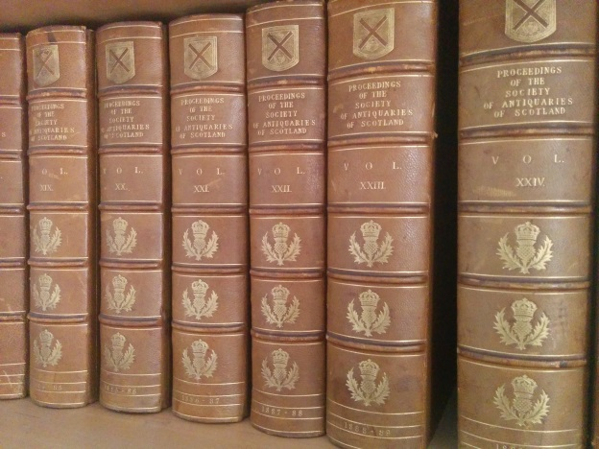
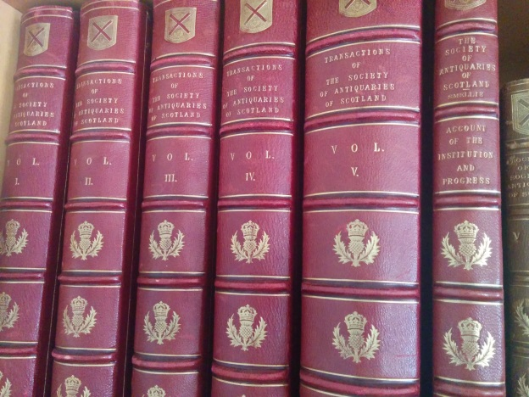
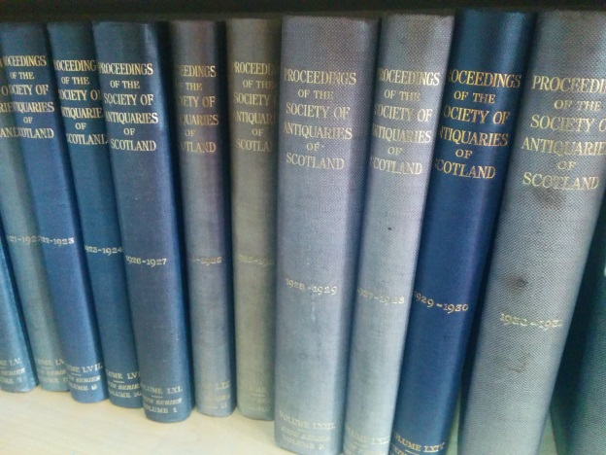
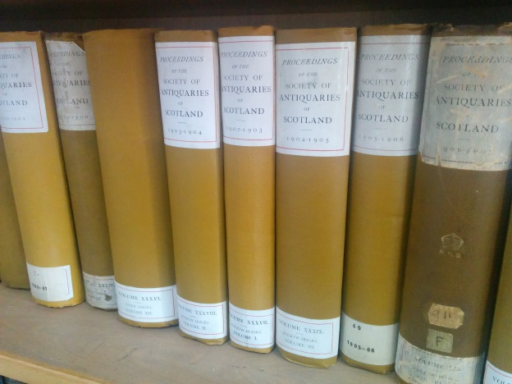
Moving to Open Access
Notes:
Last year, our Council finally agreed to move towards full Open Access publication of both of our journals – free at the time of publication. Articles Processing Charges will be charged to those who have funding from Historic Scotland or research councils, but the Society will fund those papers which don’t have funding available to them.

Slide 7
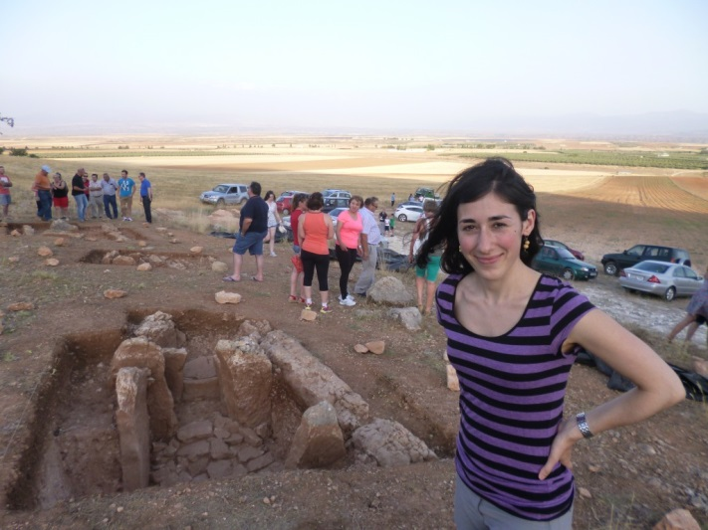
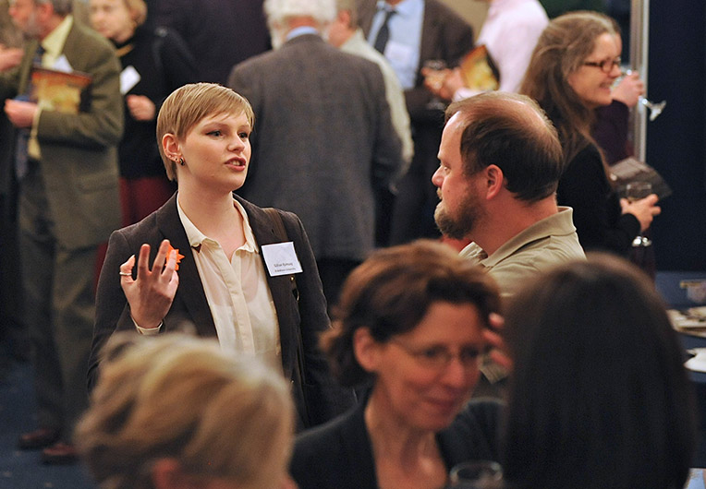
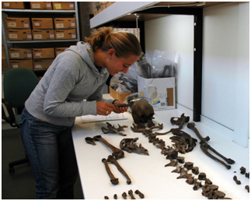
That’s great, but…
How do we talk about this to our
Fellows?
Benefits for authors
Benefits for researchers
Benefits for the community
Notes:
For many of our Fellows, moving away from print means that they’re losing a benefit of membership.
Authors – greatly increased

Slide 8
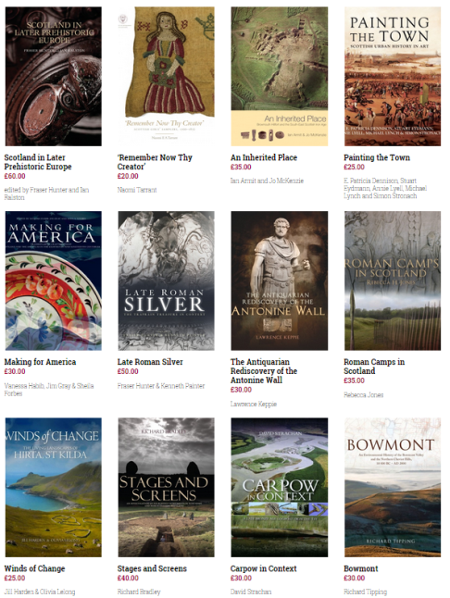
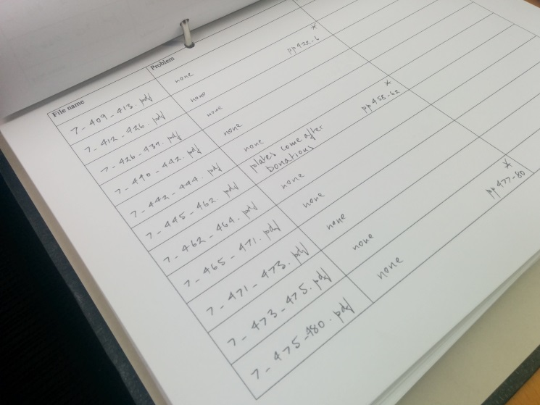
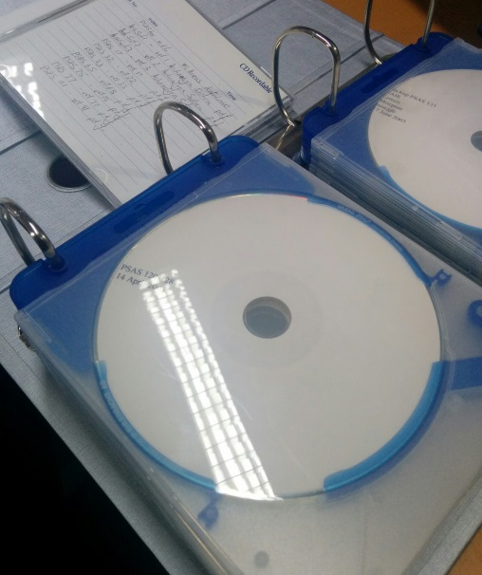
Pilot project
Out-of-print books (fewer than 30)
Already digitized
Small scale, but also complex content
Creating methodology for future expansion
Notes:
The other question is: how do we make this happen?

Slide 9
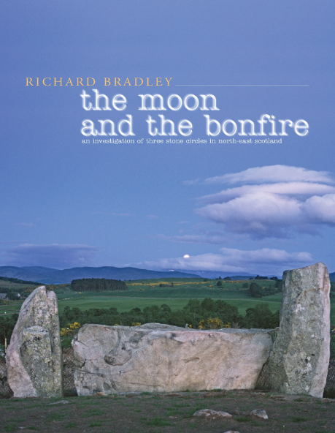
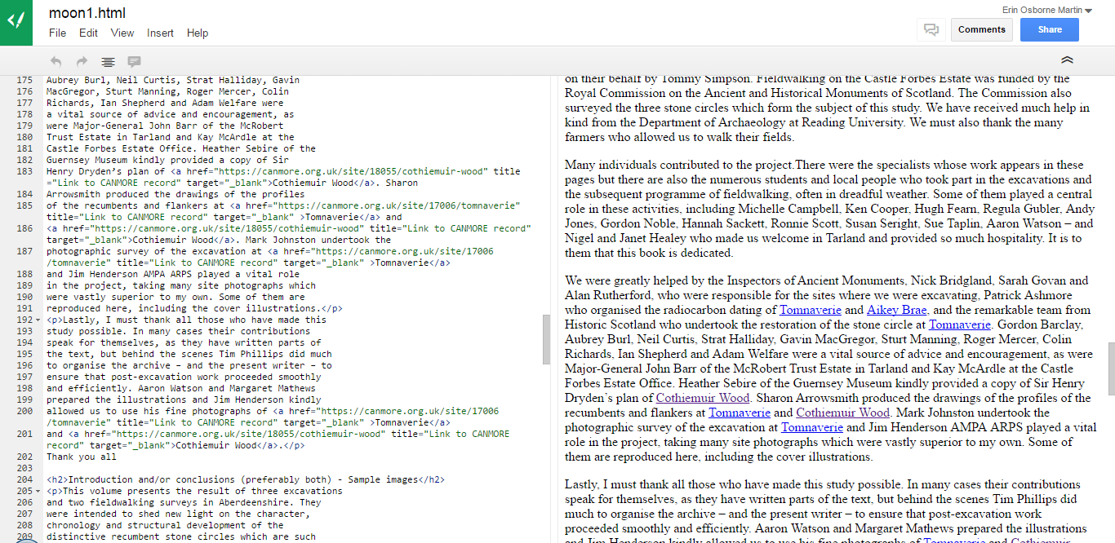
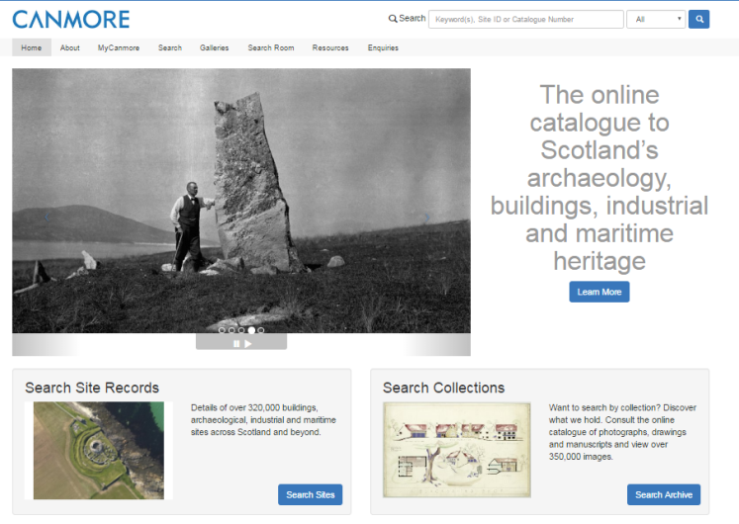
What do we need?
Book/article-level DOIs
Search functionality
Links to CANMORE
Notes:
Full-text search functionality across all items in a group (ie, books) as well as in a collection (all of the Society’s publications together)

Slide 10
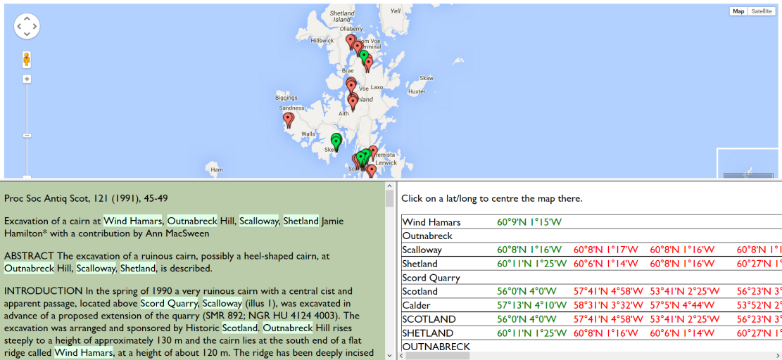
What do we want?
(aka: Phases 2 through infinity)
Notes:
Map interface/location-based searching
Google Scholar indexing
Entry in DOAJ
Analysis of site visitors and readers
The idea is that by making this an iterative process, with relatively small-scale stages that each offer opportunities for feedback, improvement and gradual process, it will be achievable even for a relatively small team.

Slide 11
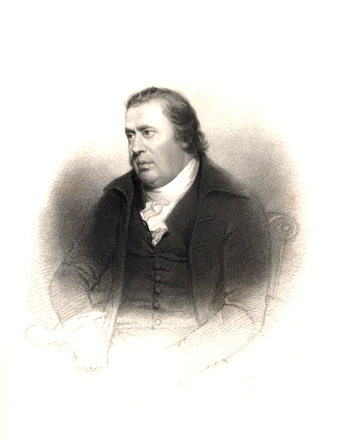
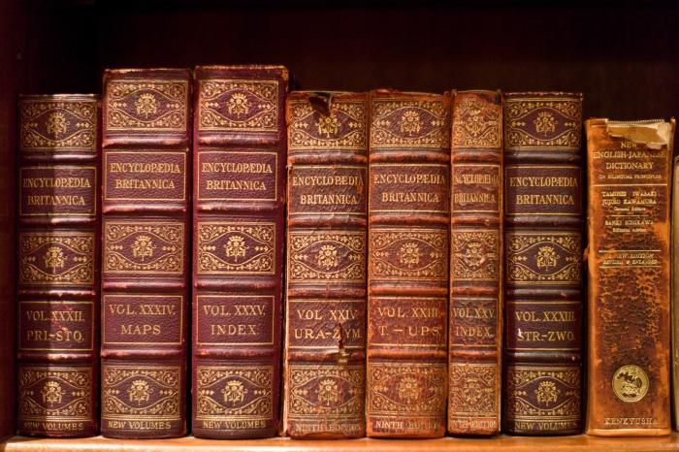
A book by any other name?
Introducing… the Smellie Collection
Notes:
William Smellie – creator of the first ever encyclopedia Brittanica (1768 to 1771)
Society of Antiquaries’ Superindentant of Natural History
He wrote The Philosophy of Natural History

Slide 12
Thank you!
eosbornema@wiley.com
emma@socantscot.org
@EKOsborneMartin
@ScARFhub
www.scottishheritagehub.com

