Slide 1
Two methods for
semi-automated feature extraction
from lidar-derived DEM
designed for cairn-fields and burial mounds
Benjamin ŠTULAR

Slide 2
Methodological Considerations
The most time consuming part of the lidar data processing in archaeology is archaeological interpretation.
This CANNOT be automated.

Slide 3
Methodological Considerations
Sometimes the transcription of archaeological features (“vectorization”) is time consuming.
This CAN BE automated in certain cases.

Slide 4
Suitable Types of Archaeological Features
paths (Vletter 2014)
pits (TRIER, PILØ 2015)
kilns (Schneider et al. 2015)
burial mounds and cairn-fields

Slide 5
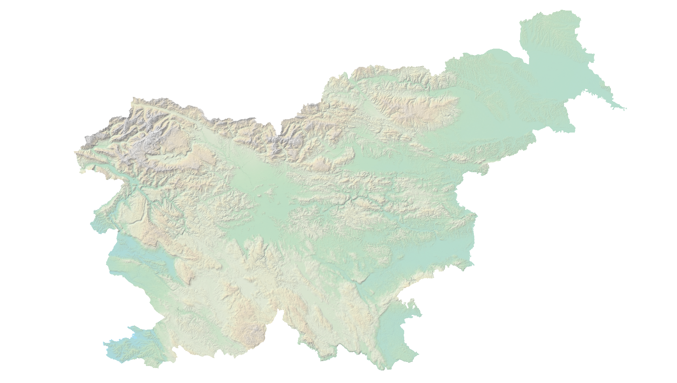
Case Studies
Visoko
Knežak
Slovenia

Slide 6
Method
Input DEM
DEM analysis
Binary values extraction
Shape and size detection
Extracting features

Slide 7
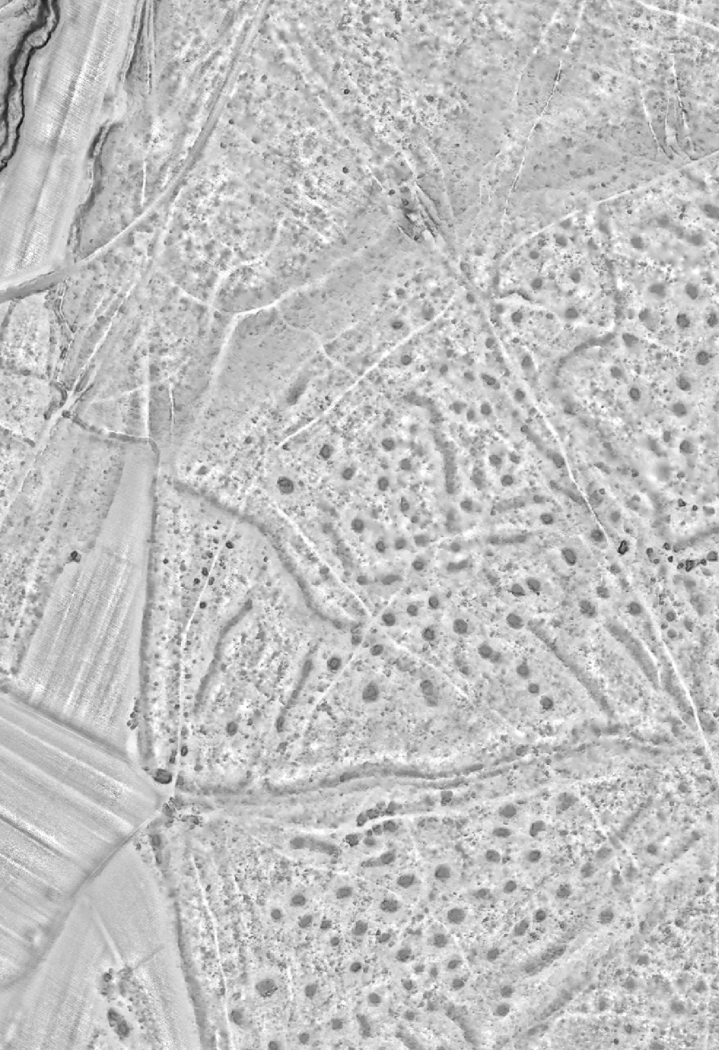
Method
Input DEM
DEM analysis
Binary values extraction
Shape and size detection
Extracting features

Slide 8
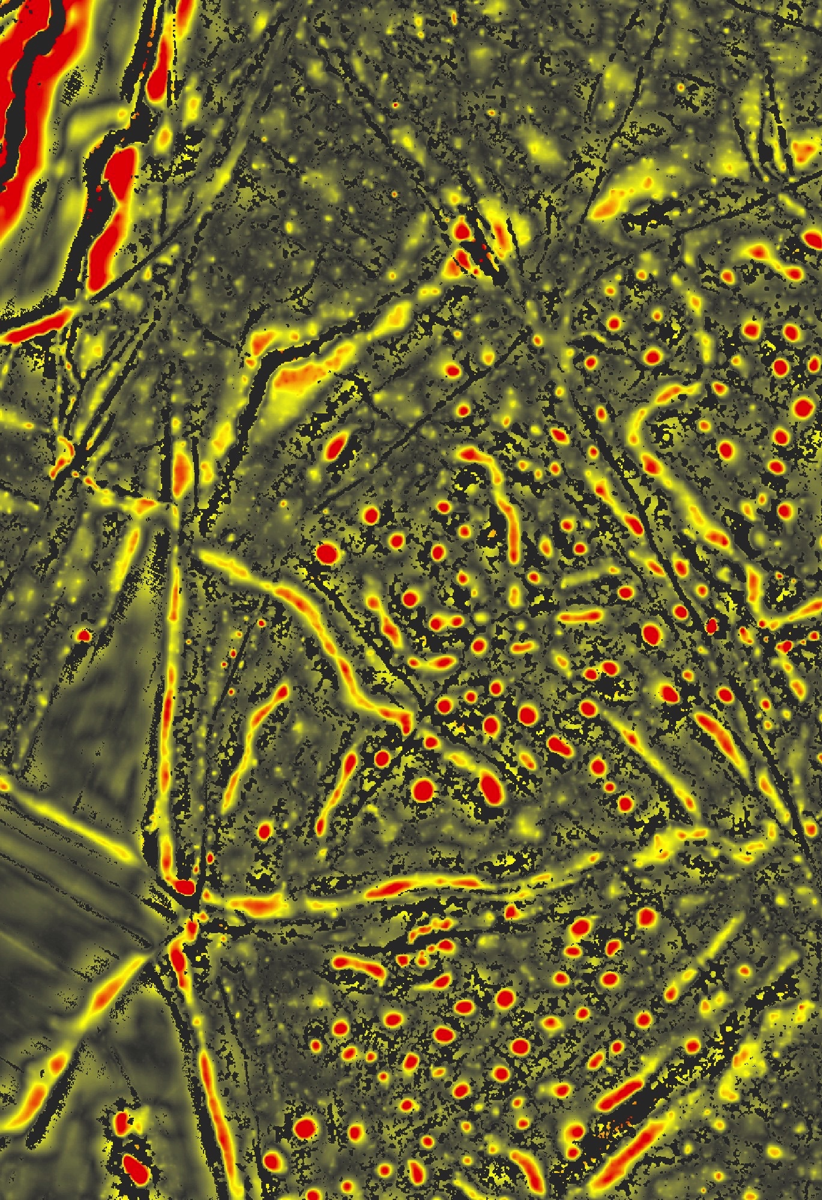
Method
Input DEM
DEM analysis
Binary values extraction
Shape and size detection
Extracting features

Slide 9
Method
Input DEM
DEM analysis
Binary values extraction
Shape and size detection
Extracting features

Slide 10
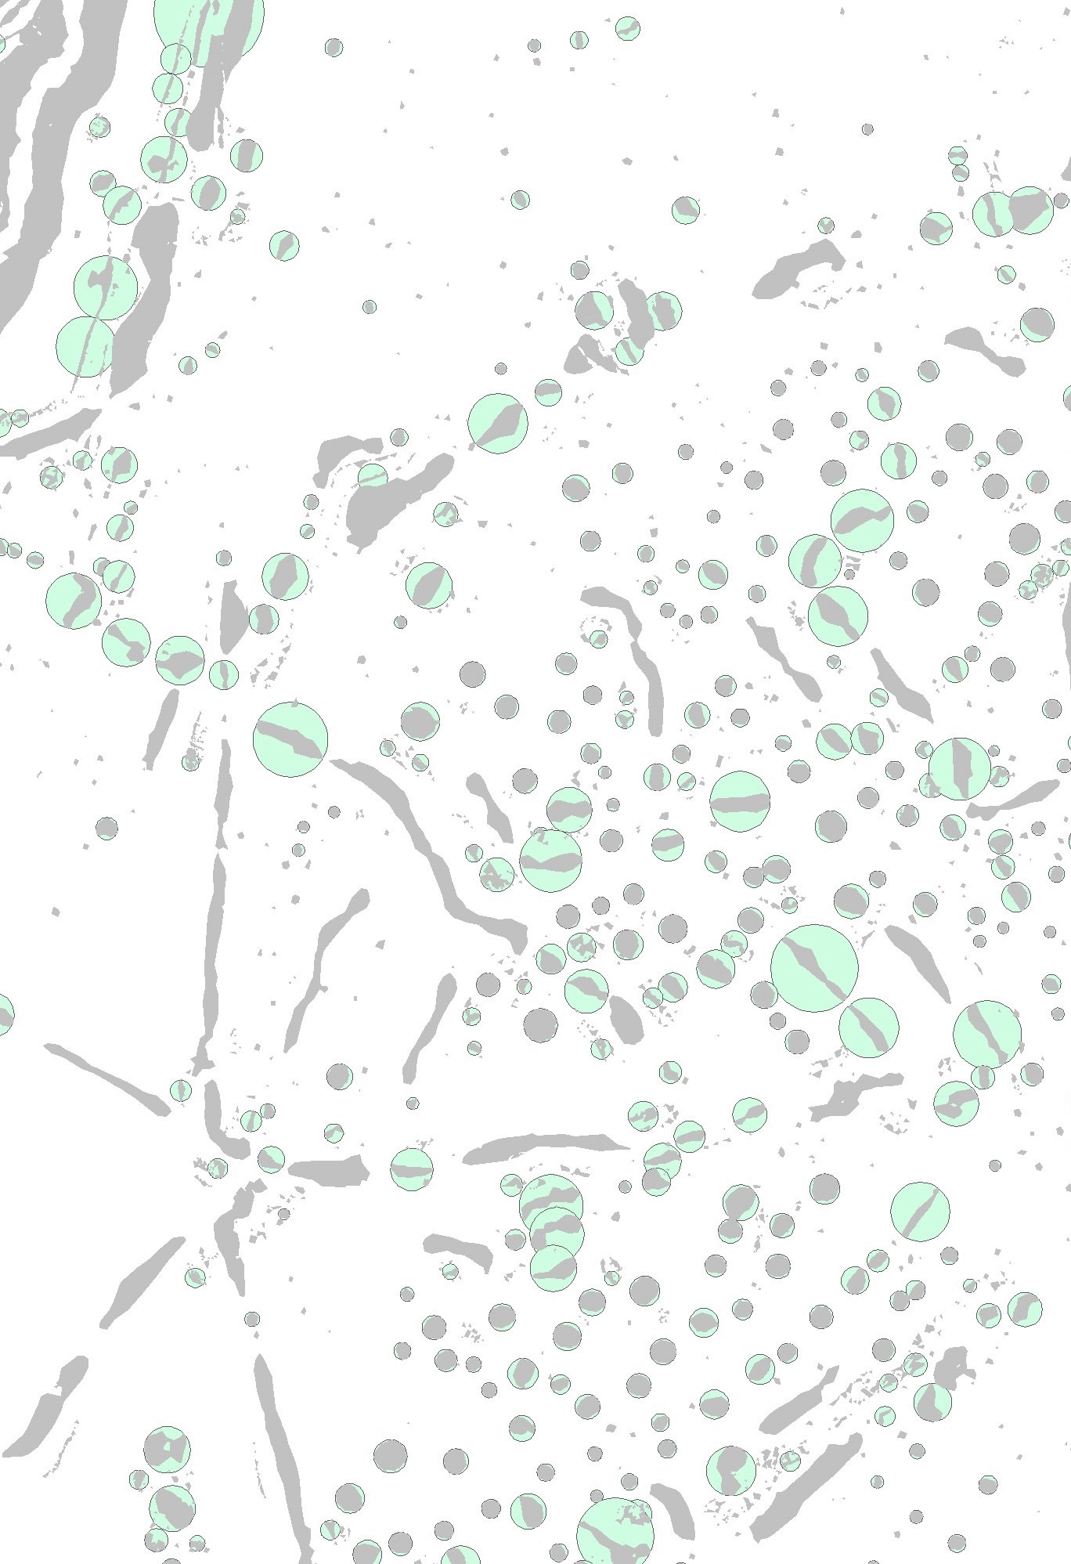
Method
Input DEM
DEM analysis
Binary values extraction
Shape and size detection
Extracting features

Slide 11
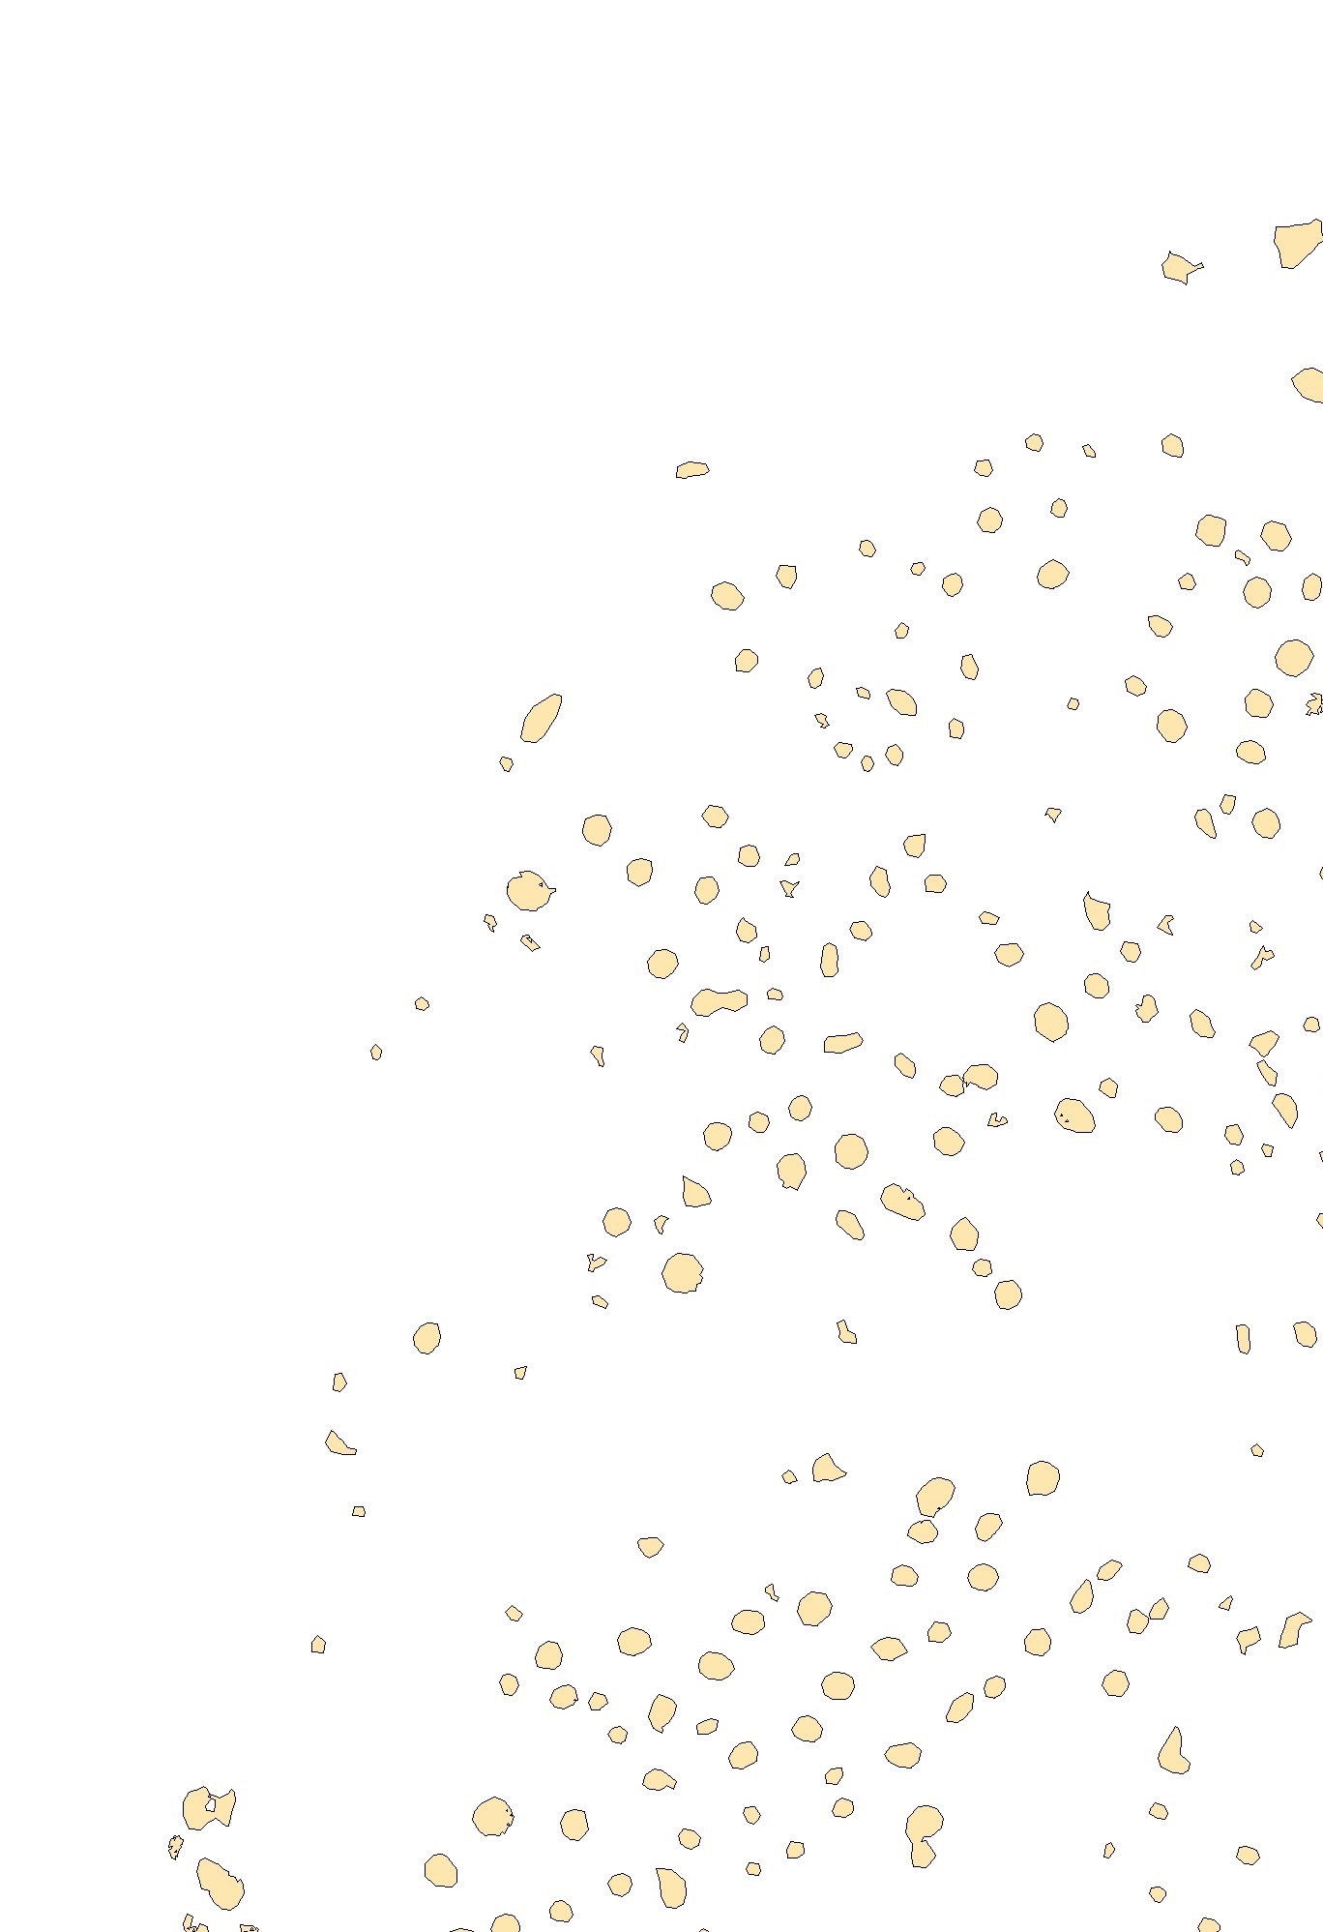
Method
Input DEM
DEM analysis
Binary values extraction
Shape and size detection
Extracting features

Slide 12
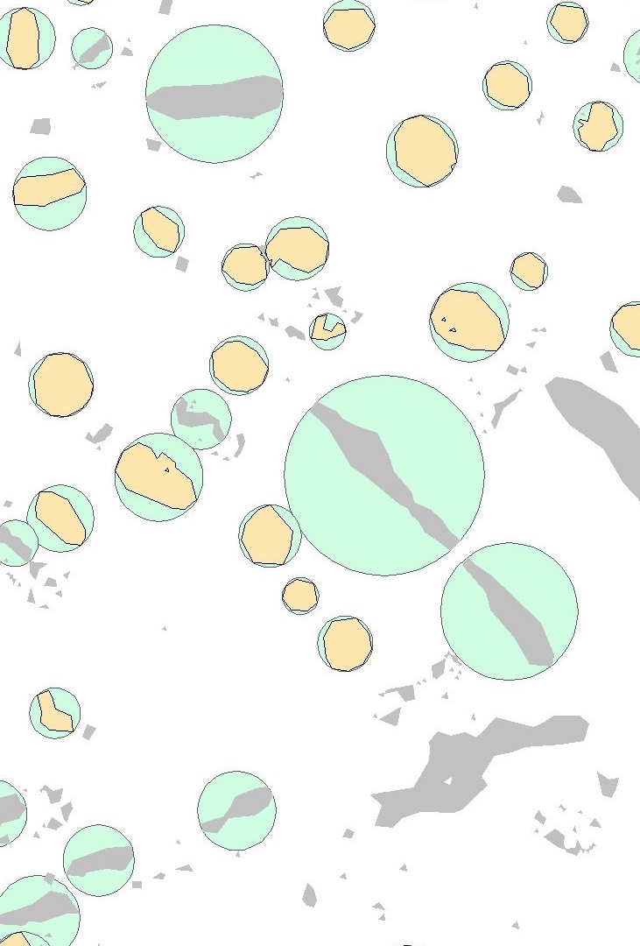
Binary values extraction
Shape and size detection
Extracting features

Slide 13
Method
Input DEM
Peakedness
DEM analysis
Elevation residuals
Binary values extraction
Shape and size detection
Extracting features

Slide 14
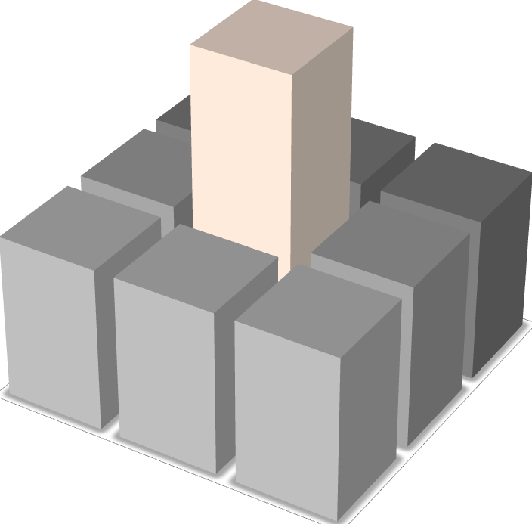
Peakedness
Peakedness is defined as a degree of belonging to a peak. Value 1 defines the summit and it decreases towards 0 down the side of the peak as it approaches the foot of a hill.
–Wood, J. 1996, The Geomorphological Characterisation of Digital Elevation Models. PhD Thesis, City University London

Slide 15
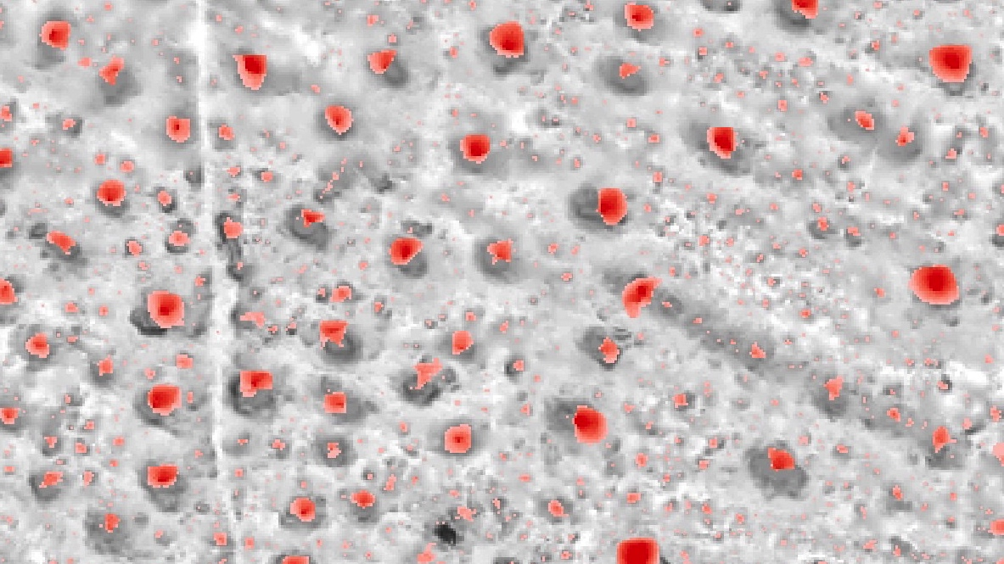

Slide 16
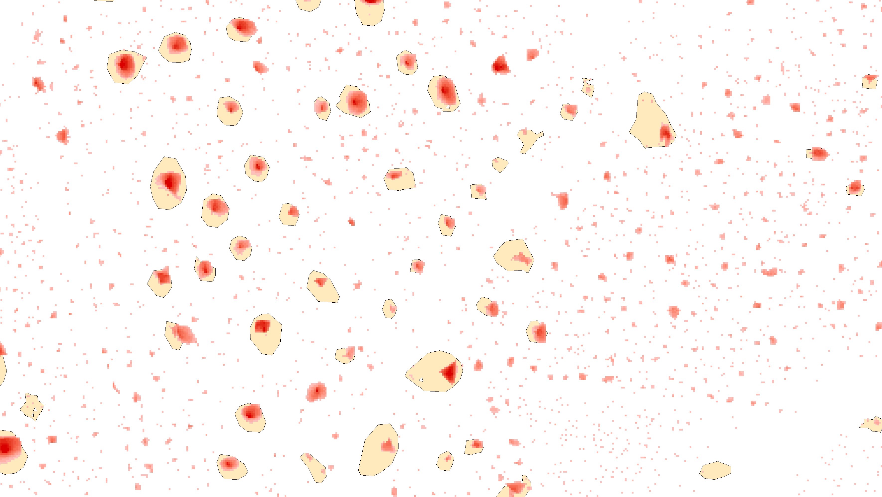

Slide 17
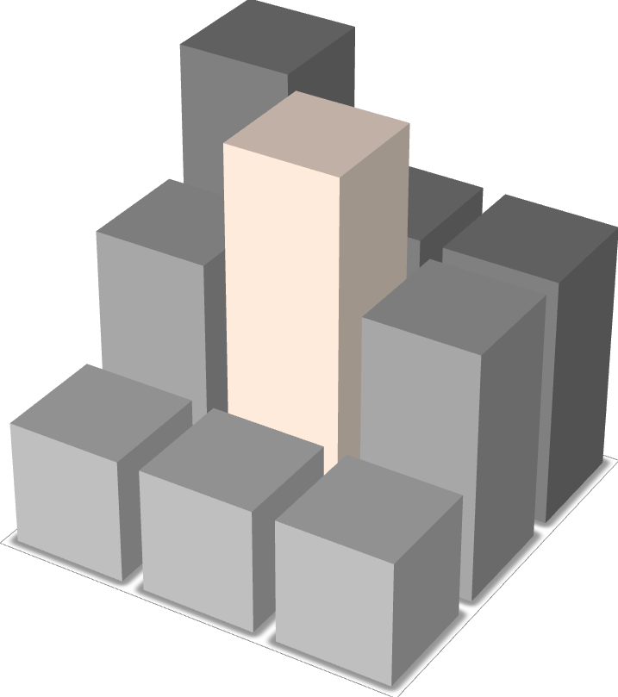
Elevation Residuals
Elevation residuals are topographic indices derived from DEMs using spatial filtering techniques (i.e. a roving window of radius r is centered on each grid cell in the DEM) to quantify the spatial pattern of topographic position or ruggedness within the context of a surrounding area.

Slide 18
Elevation Residuals

Slide 19
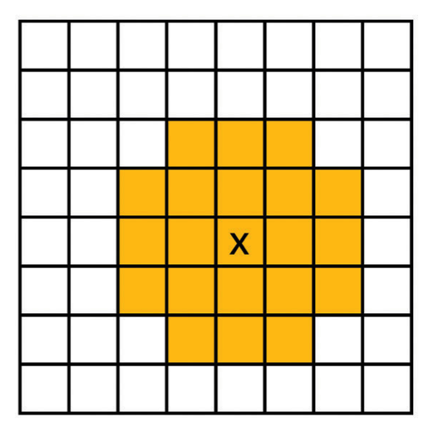
Deviation from mean elevation (DEV)
Difference between the window center's elevation and its mean elevation; elevation difference is normalized by:
D = size of the window
z0: elevation of the window center cell
zD: window mean elevation.

Slide 20
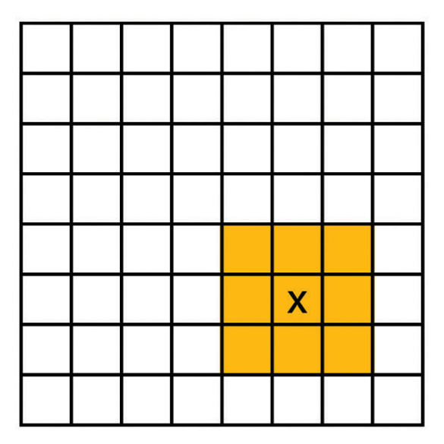
Quadratic Approximation
Mean of difference between height at centre and its quadratic approximation
Standard deviation of difference between height at centre and its quadratic approximation

Slide 21
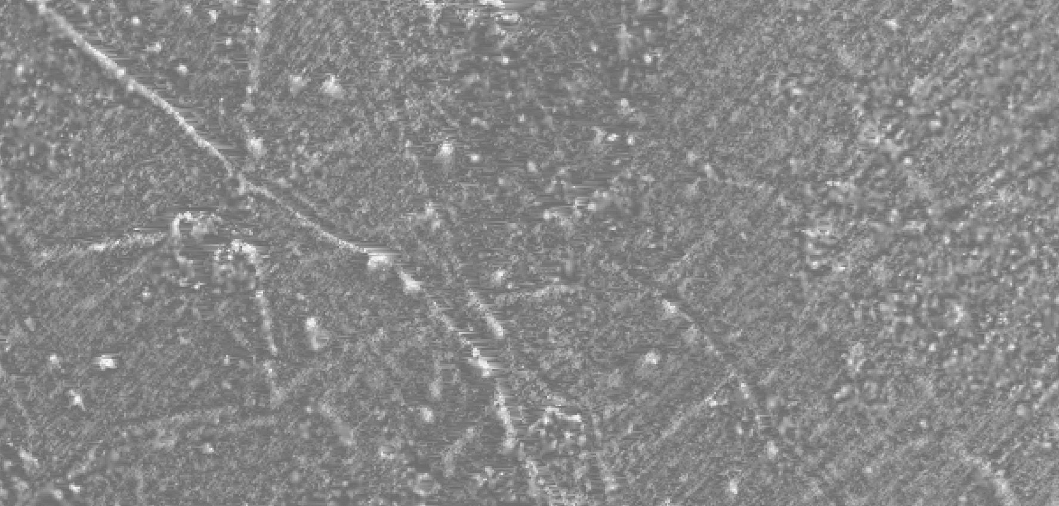
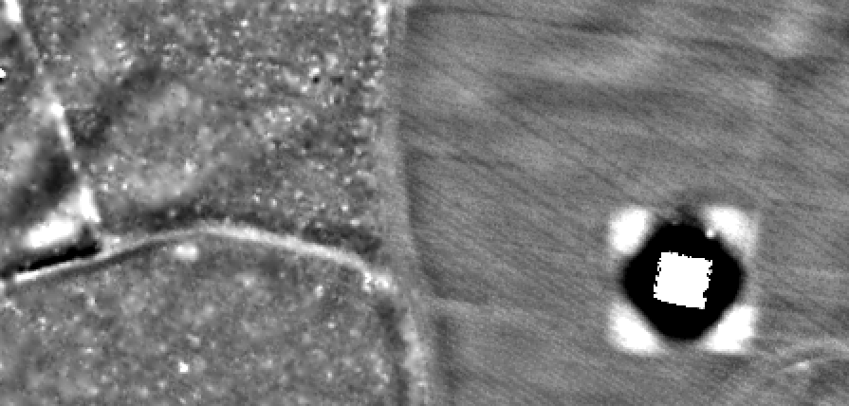
Elevation Residuals
DEV
single-scale
radius (circular)
Quadratic
multi-scale
cell (square)

Slide 22
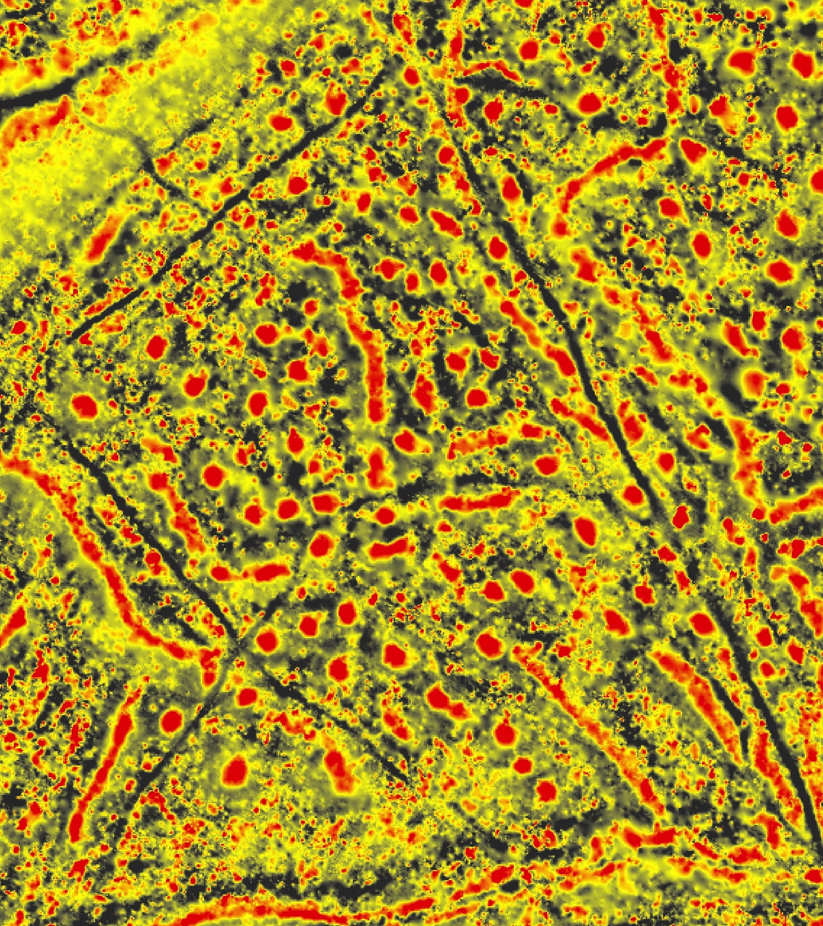
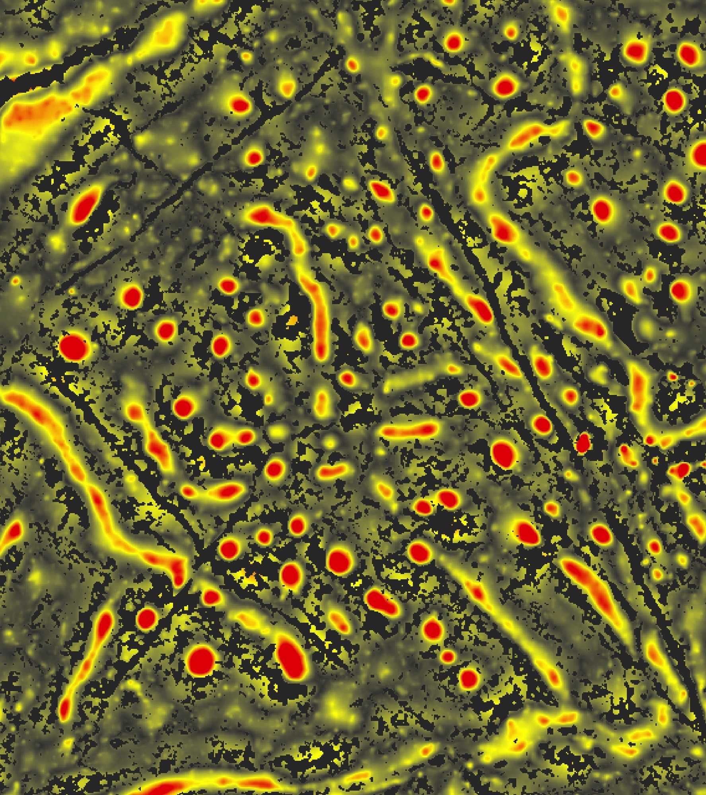
DEV
DQuadratic
Deviation from mean elevation
r = 15 m
Standard deviation (quadratic)
window size = 109

Slide 23
Case Studies
Visoko
Knežak
Slovenia

Slide 24
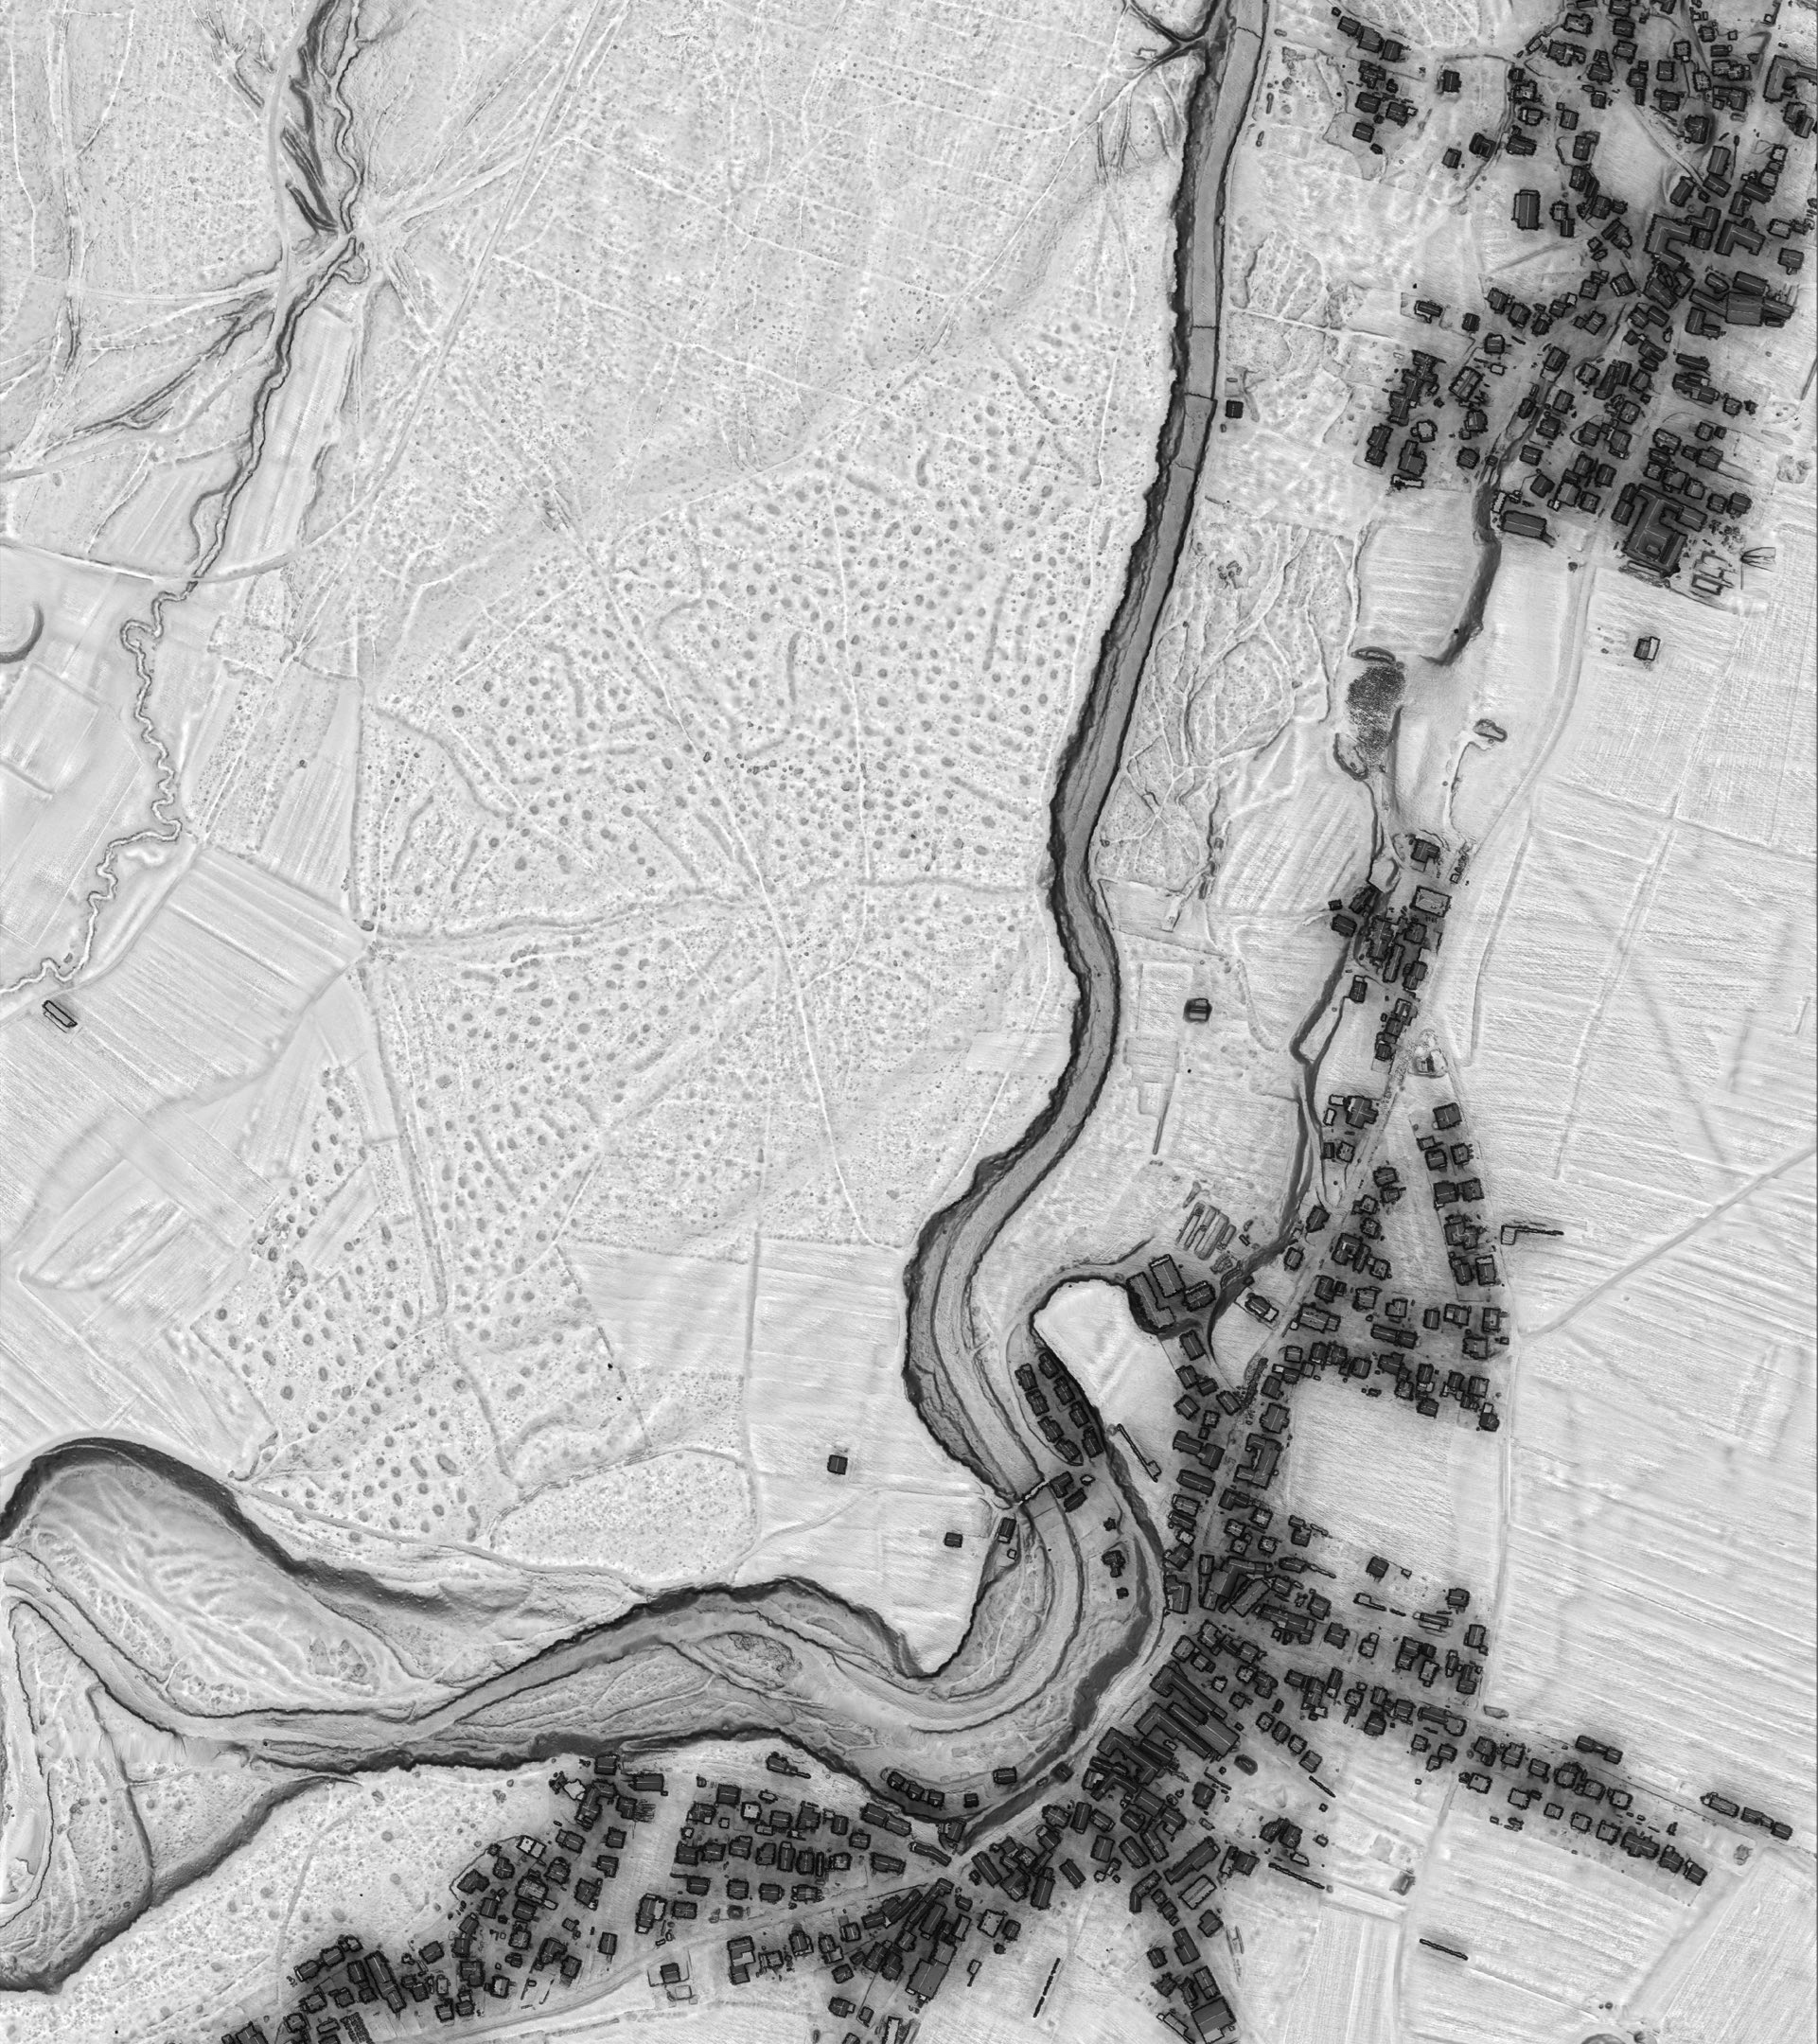
1st Case Study:
Visoko

Slide 25
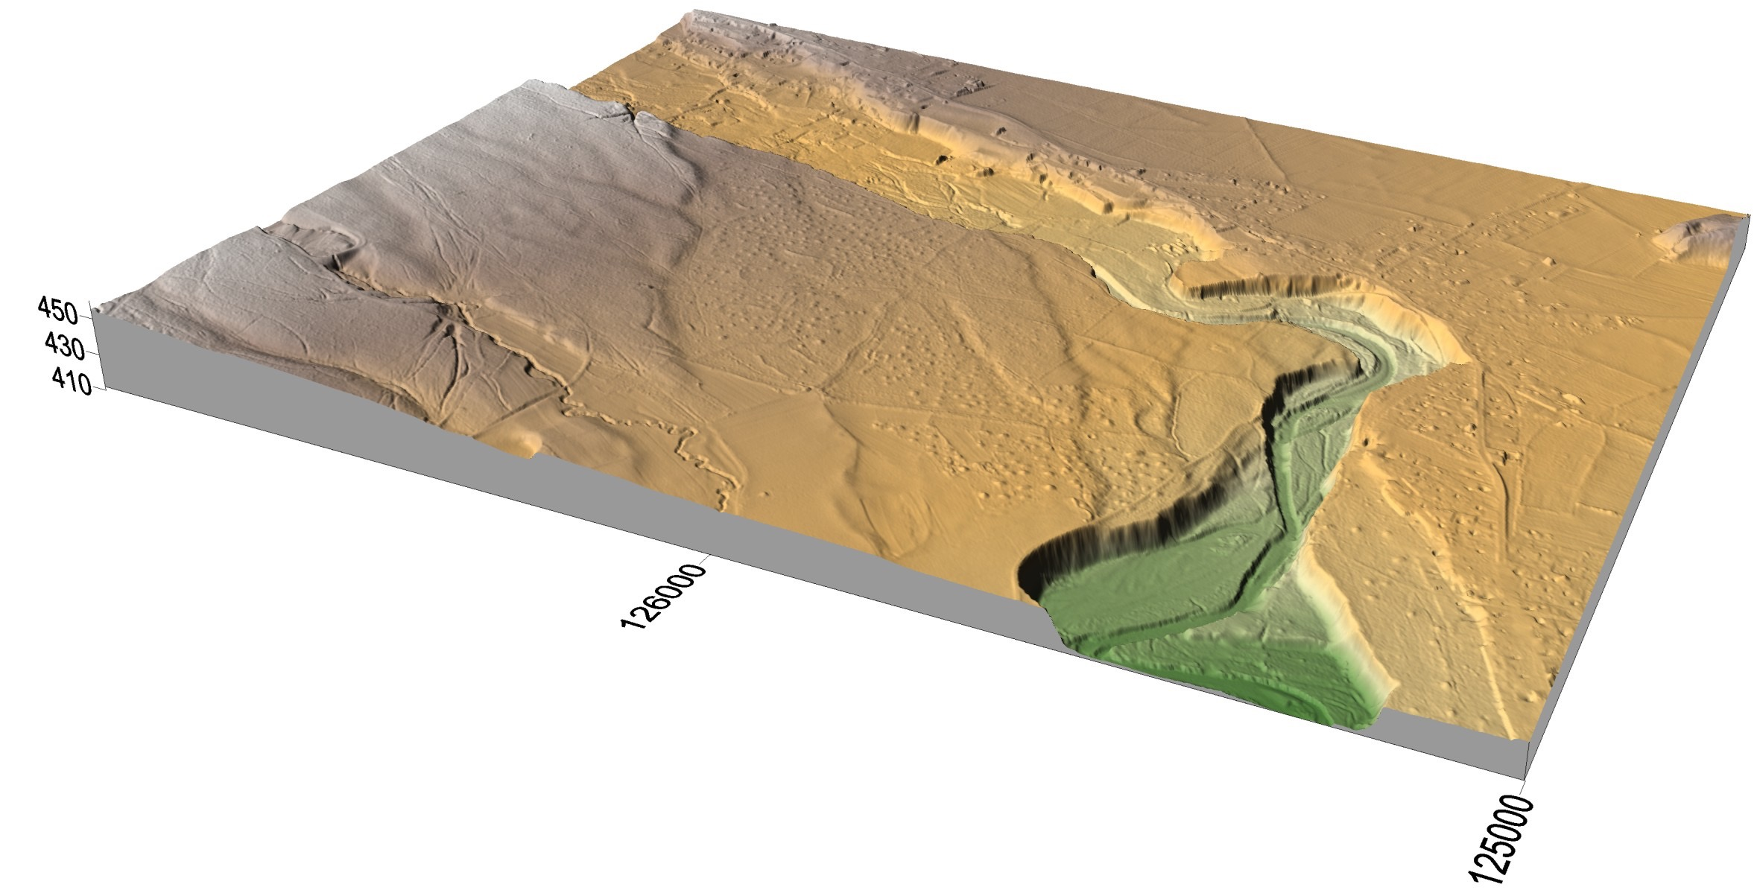
1st

Slide 26
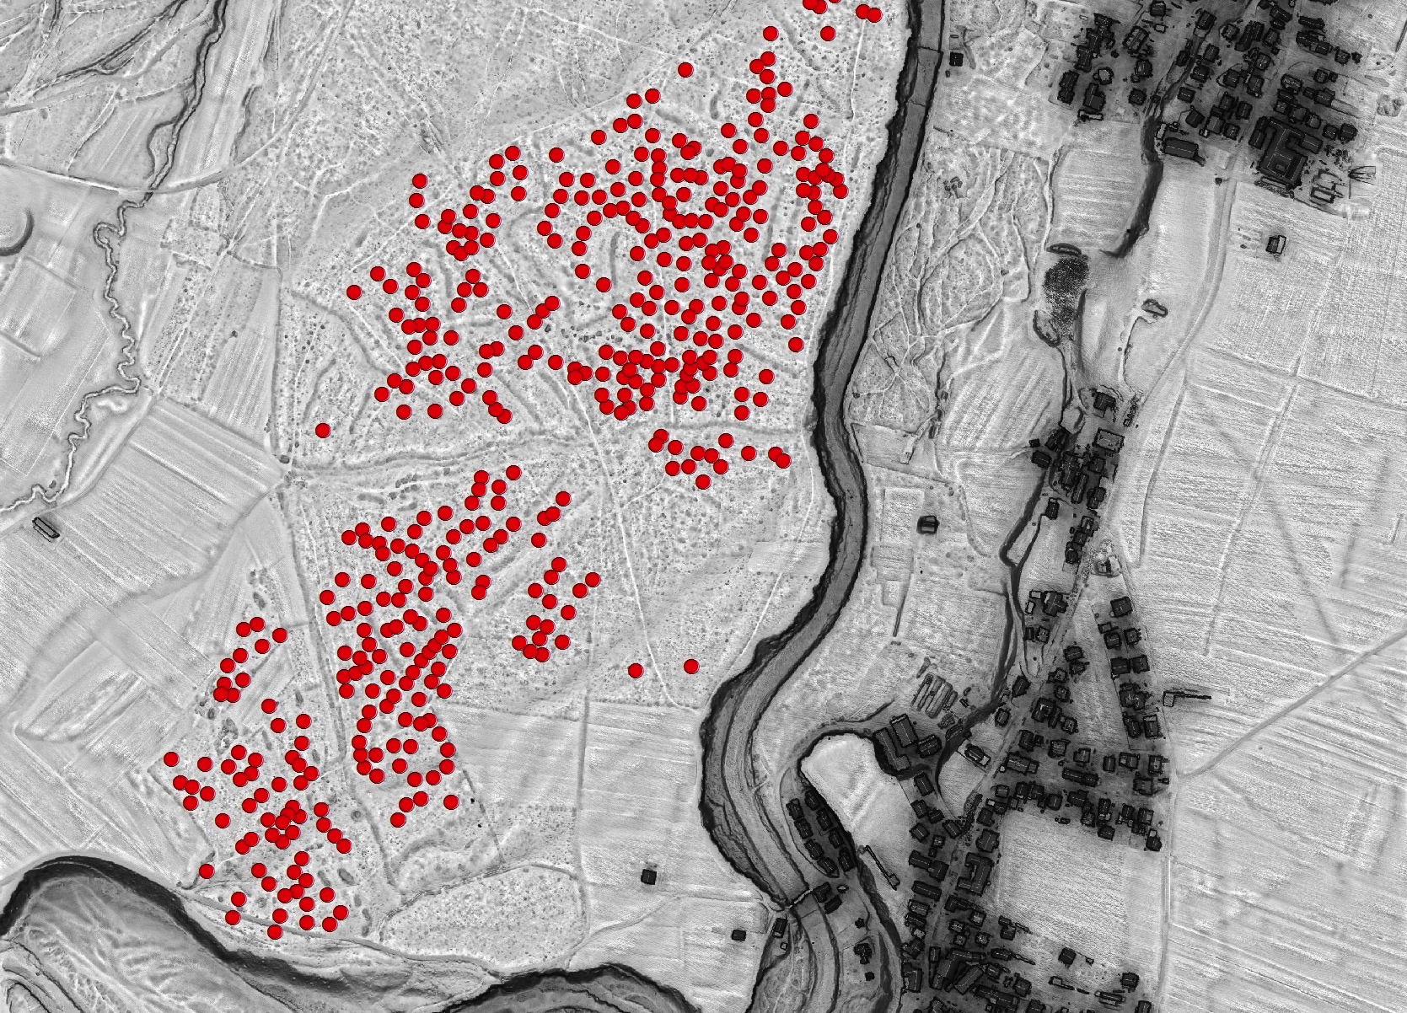
1st
448 Cairns

Slide 27
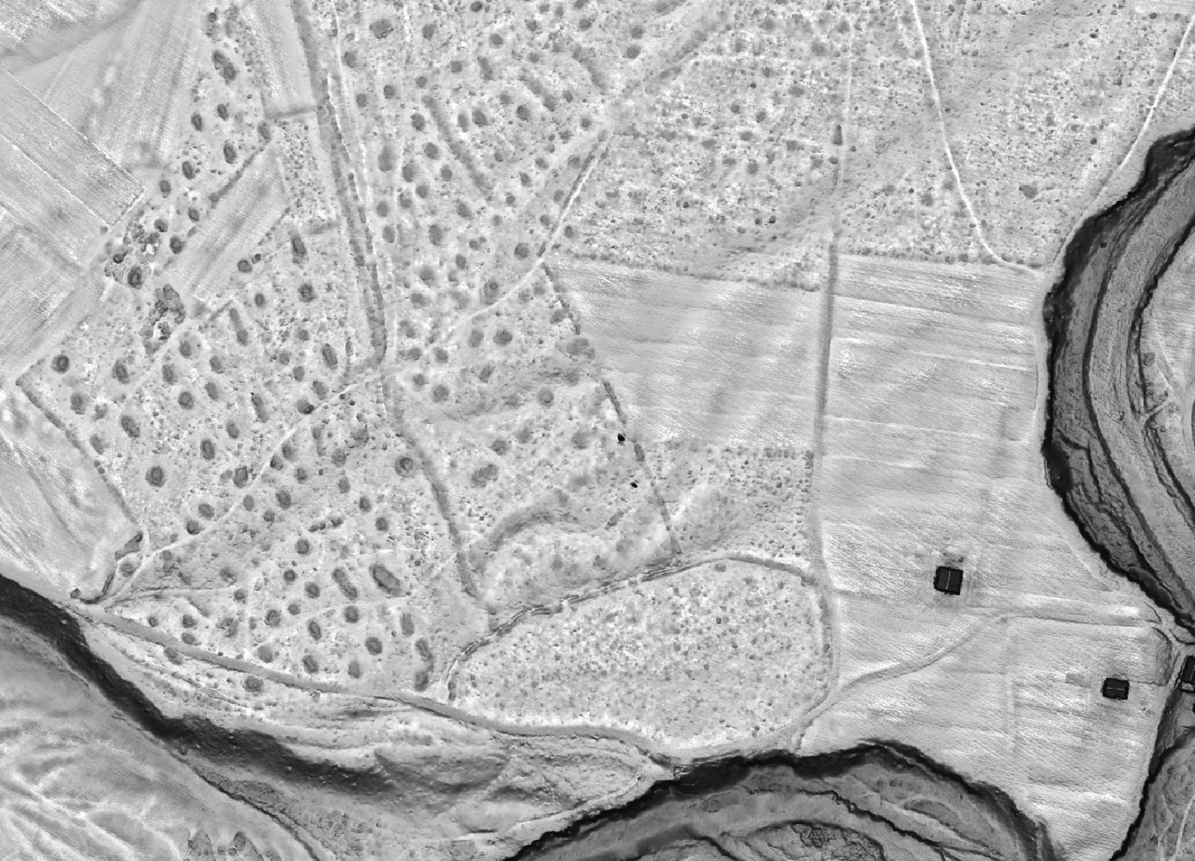
1st
448 Cairns

Slide 28
1st
448 Cairns
Peakedness

Slide 29
1st
448 Cairns
Deviation

Slide 30
1st
448 Cairns
Quadratic -Mean

Slide 31
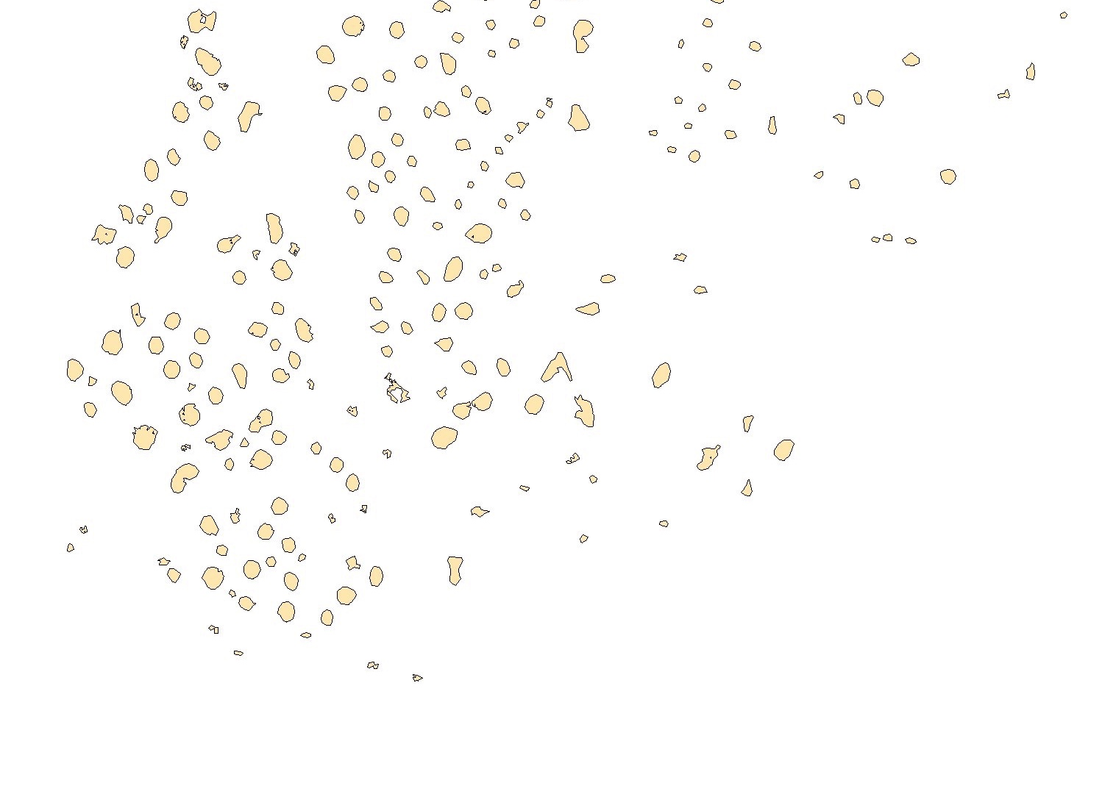
1st
448 Cairns
Quadratic - StDev

Slide 32
Results: 1st Case Study
 | Manual detection | Positive No. | Positive % | False positive | False positive
Peak | 448 | 424 | 94,6 | 2527 | 5,96
Deviation | 448 | 433 | 96,7 | 1588 | 3,58
Q - Mean | 448 | 443 | 98,9 | 1244 | 2,81
Q - StDev | 448 | 426 | 95,1 | 597 | 1,40

Slide 33
Case Studies
Visoko
Knežak
Slovenia

Slide 34
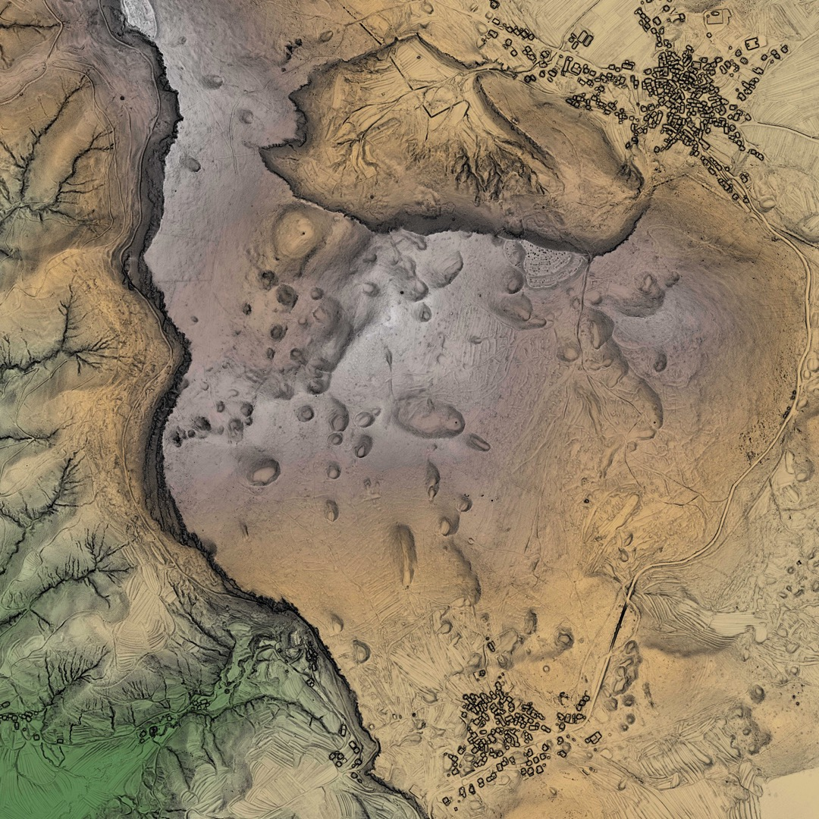
2nd Case Study:
Knežak

Slide 35
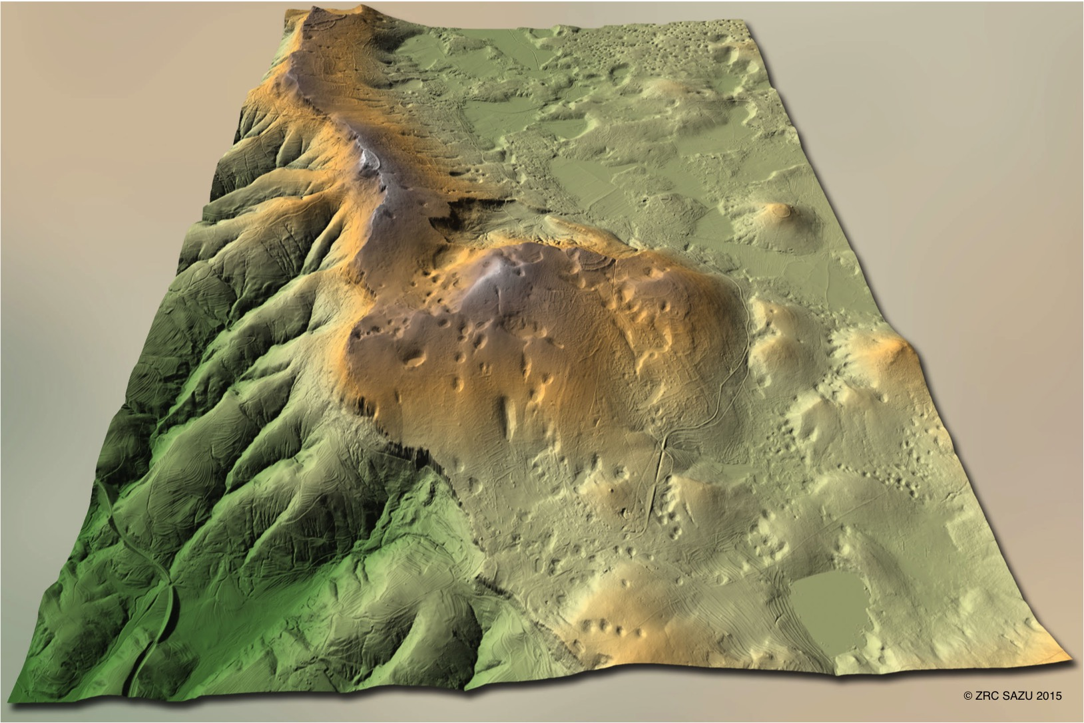
2nd

Slide 36
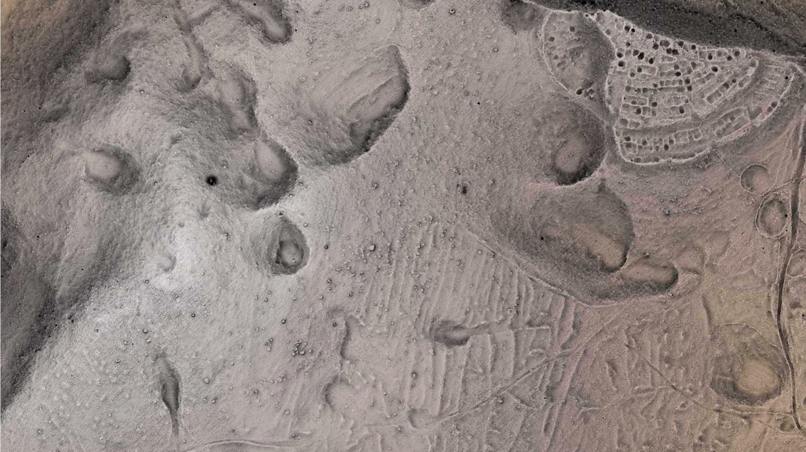

Slide 37
Results: 2nd Case Study
 | Manual detection | Positive No. | Positive % | False positive | False positive
Peak | 403 | 271 | 67,2 | 1793 | 6,62
Deviation | 403 | 350 | 86,8 | 2444 | 6,98
Q -Mean | 403 | 304 | 75,4 | 1042 | 3,43
Q - StDev | 403 | 243 | 60,3 | 684 | 2,81

Slide 38
Take-Home Message

Slide 39
Workflow (cca. 500 cairns)
Manual point-detection of cairns (½ hour)
Semi-automatic feature extraction (1 hour or more*)
Manual “desk-based-truthing” (½ hour)
Data extraction, e.g. size, shape, height (minutes)

Slide 40
TOTAL: 2 ¼ hours*
Total manual: 5-8 hours

Slide 41
Makes sense?
98,9% / 1,4 x
86,8% / 2,8 x

Slide 42
Help with feature extraction - YES
Archaeological interpretation - NO
Semi-automated Feature Extraction

