Slide 1
Linked Open Data Approaches within the ARIADNE project
@ARIADNE_Network
ariadne-infrastructure.eu
portal.ariadne-infrastructure.eu
Holly Wright
Archaeology Data Service, University of York, UK

Slide 2
What is ARIADNE?
A proposal to integrate existing archaeological data infrastructures across Europe, so researchers can use the various distributed datasets and new technologies to explore new research methodologies.

Slide 3
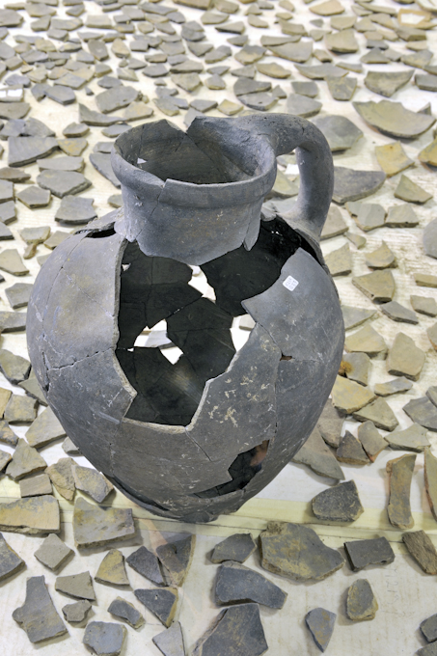
What is ARIADNE?
Stimulate new research avenues in the field of archaeology, relying on the comparison, re-use and integration into current research, the outcomes of past and on-going field and laboratory activity.

Slide 4
ARIADNE Activities
Research Workpackages
Implementing Interoperability
Developing Integrated Services
Addressing Complexity
Linking Archaeological Data
Data Mining and Natural Language Processing
Innovation in Archaeological Research Methodology

Slide 5
Focus
How does working with Linked Data make the ARIADNE project more open?
What Linked Data approaches are used by ARIADNE?
Lessons learned: How can archaeological data be more open?

Slide 6
ARIADNE and Linked Data
How does working with Linked Data make the ARIADNE project more open?
Using Linked Data is a way to make data more easily processable by machines, more automated
A way to make heterogeneous data more interoperable and searchable (often) by linking with other data by mapping to an authoritative vocabulary or mapping between vocabularies
A way to infer new information from existing data

Slide 7
ARIADNE and Linked Data
Just because your using Linked Data doesn’t mean your data is open (LOD)
Linked Data is a technical solution for breaking down data silos and creating a Web of Data instead of a Web of Documents (pages)
The data still has to be open and accessible, through open licensing and open dissemination

Slide 9
ARIADNE and Linked Data
What Linked Data approaches are used by ARIADNE?
What: Mapping subjects to Getty Art & Architecture Thesaurus (controlled)
When: Contributing to/using PeriodO (assertions) for time periods

Slide 10
Mapping to the AAT
Manually matched vocabulary concepts to Getty Art & Architecture Thesaurus (AAT) concepts; a popular LOD vocabulary
Used the AAT as a ‘mediating platform’ or neutral spine to map concepts in national languages
Partners at the University of South Wales created a bespoke thesaurus mapping tool for the task, but tool is openly available for use outside of ARIADNE

Slide 11
http://www.heritagedata.org/vocabularyMatchingTool/

Slide 12
Mapping to the AAT
Manually matching vocabulary concepts to Getty Art & Architecture Thesaurus (AAT) concepts
Uses linked data – Javascript components using external SPARQL endpoints (no back-end)
Side by side comparison of concepts, with contextual details (labels, scope notes, linked concepts)
Multilingual - French, German, Spanish, English, Dutch AAT concept details
Export created mappings to JSON, CSV, RDF

Slide 13
Mapping to the AAT

Slide 14
Mapping to the AAT

Slide 15
Mapping to the AAT

Slide 16
Mapping to the AAT

Slide 17
Working with PeriodO
PeriodO is a LOD gazetteer for linking and visualising data
It contains scholarly definitions of historical, art-historical and archaeological period
Allows easier linking of datasets that define periods differently (when is always linked with where in archaeology)
Allows users to see where period definitions overlap or diverge

Slide 18
Working with PeriodO
Issues with interoperability and time in archaeology
We often use conceptual, rather than quantitative language to refer to time (e.g. Bronze Age)
Different people can use the same period terms to refer to very different things (Bronze Age happens at different times and can have different meaning depending on place)

Slide 19
Working with PeriodO
The PeriodO approach
Documents definitions of periods by authoritative sources (assertion and attribution)
Corresponds with traditional scholarly practice, so users know what place is associated with the assertion, and who says so (what authoritative source has contributed the assertion)

Slide 20
Working with PeriodO
How ARIADNE is working with PeriodO
All ARIADNE content-providing partners were asked to submit the authoritative period terms in use in their country or region, in their national languages to PeriodO
The submitted terms were given PeriodO Linked Data URIs (Linked Data addresses) and incorporated into the gazetteer for use within ARIADNE, but allowing interoperability with any other project or researcher using PeriodO

Slide 21
Working with PeriodO

Slide 22
Working with PeriodO

Slide 23
Working with PeriodO
How ARIADNE is working with PeriodO
PeriodO search is currently being implemented in the ARIADNE portal, and should be available within the next couple of months
As new associated partners are added to ARIADNE (e.g. Lithuania!) they will also be invited to submit their period terms to PeriodO, further broadening coverage across Europe

Slide 24
Lessons Learned
Lessons learned: How can archaeological data be more open?
Linked Data provides important tools for making archaeological data more open, but working together to support open practices is the real key
Most researchers have bigger concerns than making their data open as Linked Data, there is a significant learning and technology curve
Getting to this point has taken years of cooperative work by archaeologists and developers

Slide 25
Lessons Learned
Lessons learned: How can archaeological data be more open?
Archaeologists across Europe are coming under increasing pressure to deposit their data in an open repository and make it available for re-use
Pressure from funders
Pressure from institutions
Funding available but no guidance
No appropriate options for archaeological data

Slide 26
Lessons Learned
Lessons learned: How can archaeological data be more open?
This initial deposit is where support is really needed; making data available with an open license is the hardest work
Once data is online under an open license, opportunities to make it even more open and accessible using Linked Data become possible!

Slide 27
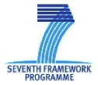
Thank You!
ARIADNE is a project funded by the European Commission under the Community’s Seventh Framework Programme, contract no. FP7-INFRASTRUCTURES-2012-1-313193.
The views and opinions expressed in this presentation are the sole responsibility of the authors and do not necessarily reflect the views of the European Commission.

